Slide 1

Data Structure and Storage
The modern world has a false sense of superiority because it relies on the mass of knowledge that it can use, but what is important is the extent to which knowledge is organized and mastered
Goethe, 1810

Slide 2
Data Structures
The goal is to minimize disk accesses
Disks are relatively slow compared to main memory
  Writing a letter compared to a telephone call
Disks are a bottleneck
Appropriate data structures can reduce disk accesses

Slide 3
Database access

Slide 4
Disks
Data stored on tracks on a surface
A disk drive can have multiple surfaces
Rotational delay
  Waiting for the physical storage location of the data to appear under the read/write head
  Around 4 msec for a magnetic disk
  Set by the manufacturer
Access arm delay
  Moving the read/write head to the track on which the storage location can be found.
  Around 9 msec for a magnetic disk

Slide 5
Minimizing data access times
Rotational delay is fixed by the manufacturer
Access arm delay can be reduced by storing files on
  The same track
  The same track on each surface
    A cylinder

Slide 6
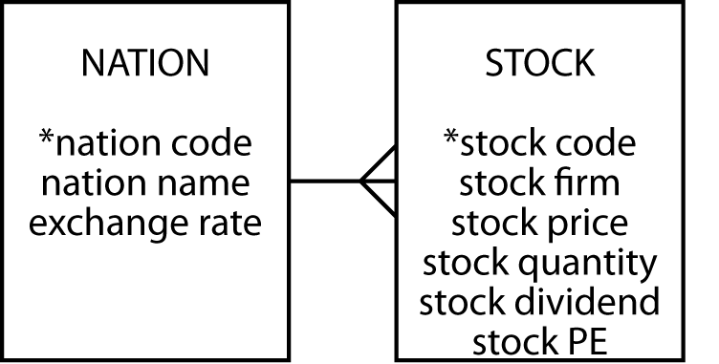
Clustering
Records that are often retrieved together should be stored together
Intra-file clustering
  Records within the one file
    A sequential file
Inter-file clustering
  Records in different files
    A nation and its stocks

Slide 7

Disk manager
Manages physical I/O
Sees the disk as a collection of pages
Has a directory of each page on a disk
Retrieves, replaces, and manages free pages

Slide 8
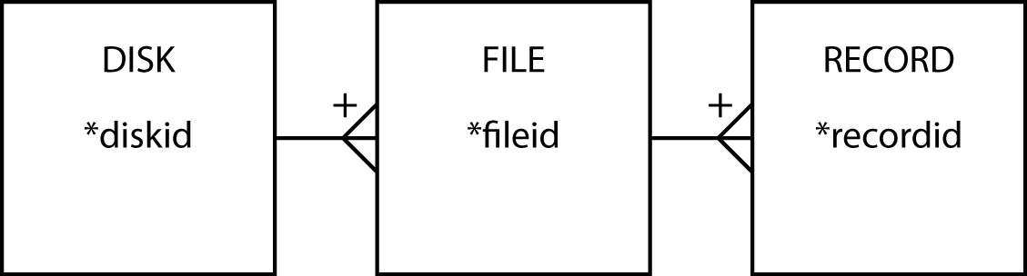
File manager
Manages the storage of files
Sees the disk as a collection of stored files
Each file has a unique identifier
Each record within a file has a unique record identifier

Slide 9
File manager's tasks
Create a file
Delete a file
Retrieve a record from a file
Update a record in a file
Add a new record to a file
Delete a record from a file

Slide 10
Sequential retrieval
Consider a file of 10,000 records each occupying 1 page
Queries that require processing all records will require 10,000 accesses
  e.g., Find all items of type 'E'
Many disk accesses are wasted if few records meet the condition

Slide 11
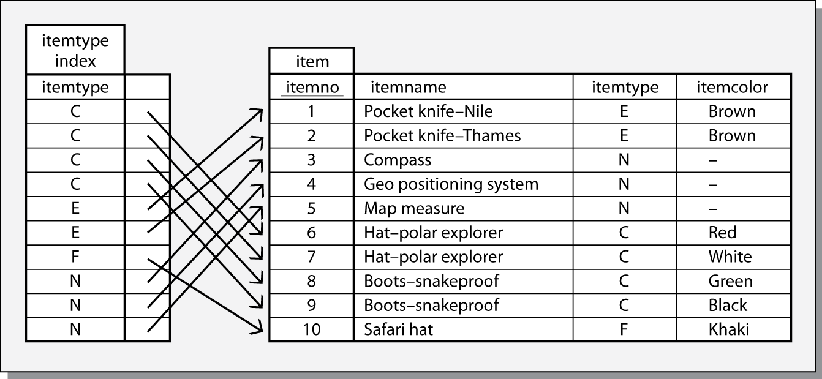
Indexing
An index is a small file that has data for one field of a file
Indexes reduce disk accesses

Slide 12
Querying with an index
Read the index into memory
Search the index to find records meeting the condition
Access only those records containing required data
Disk accesses are substantially reduced when the query involves few records

Slide 13
Maintaining an index
Adding a record requires at least two disk accesses
  Update the file
  Update the index
Trade-off
  Faster queries
  Slower maintenance

Slide 14
Using indexes
Sequential processing of a portion of a file
  Find all items with a type code in the range 'E' to 'K'
Direct processing
  Find all items with a type code of 'E' or 'N'
Existence testing
  Determining whether a record meeting the criteria exists without having to retrieve it

Slide 15
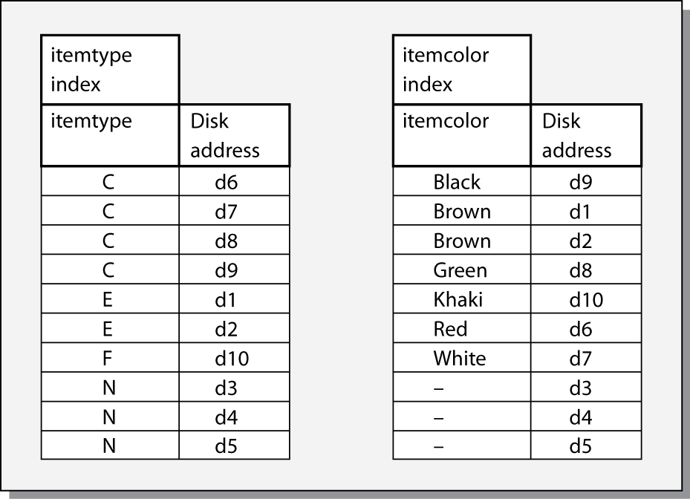
Multiple indexes
Find red items of type 'C'
  Both indexes can be searched to identify records to retrieve

Slide 16
Multiple indexes
Indexes are also called inverted lists
  A file of record locations rather than data
Trade-off
  Faster retrieval
  Slower maintenance

Slide 17
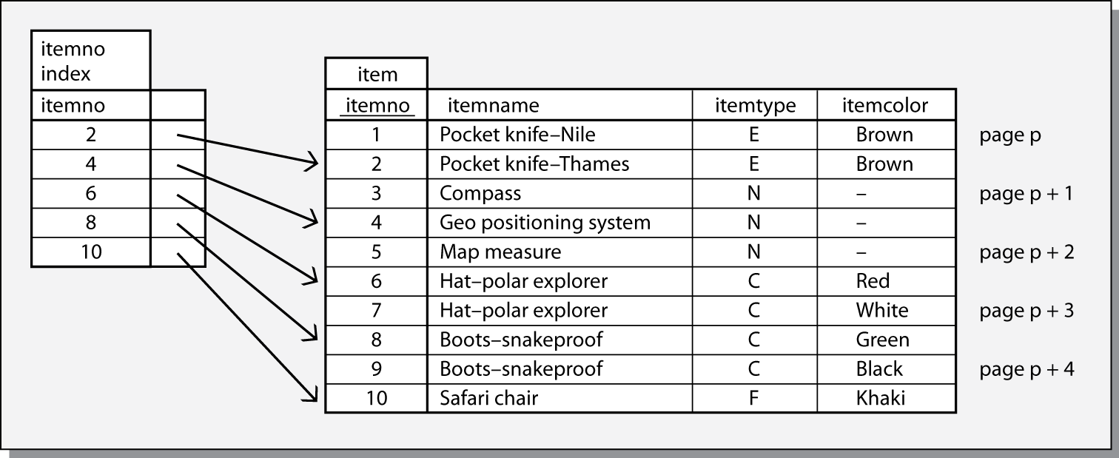
Sparse indexes
Taking advantage of the physical sequence of a file
Assume 2 records per page
Tradeoffs
  Fewer disk accesses required to read the index
  Existence tests not possible
Notes:
How many sparse indexes can a file have?
One, because it takes advantage of the physical sequence of the file

Slide 18
B-tree
A form of inverted list
Frequently used for relational systems
Basis of IBM’s VSAM underlying DB2
Supports sequential and direct accessing
Has two parts
  Sequence set
  Index set

Slide 19
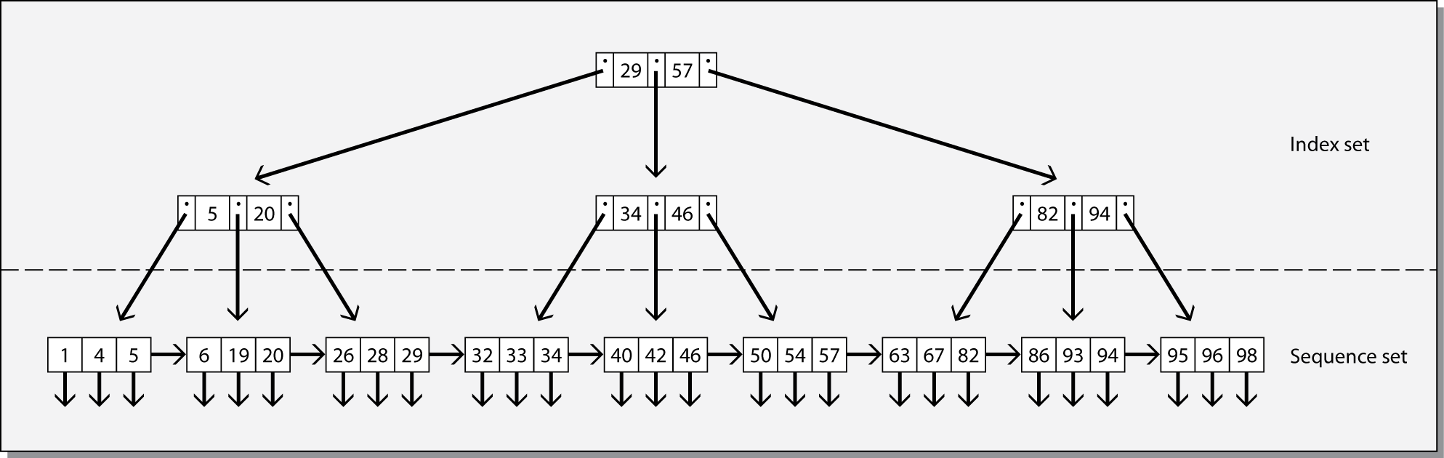
B-tree
Sequence set is a single level index with pointers to records
Index set is a tree-structured index to the sequence set

Slide 20
B+ tree
The combination of index set (the B-tree) and the sequence set is called a B+ tree
The number of data values and pointers for any given node are not restricted
Free space is set aside to permit rapid expansion of a file
Tradeoffs
  Fast retrieval when pages are packed with data values and pointers
  Slow updates when pages are packed with data values and pointers

Slide 21
Hashing
A technique for reducing disk accesses for direct access
Avoids an index
Number of accesses per record can be close to one
The hash field is converted to a hash address by a hash function
Notes:
What is the likely choice of the hash field?
The primary key

Slide 22
Shortcomings of hashing
Different hash fields convert to the same hash address
  Synonyms
  Store the colliding record in an overflow area
Long synonym chains degrade performance
There can be only one hash field
The file can no longer be processed sequentially

Slide 23
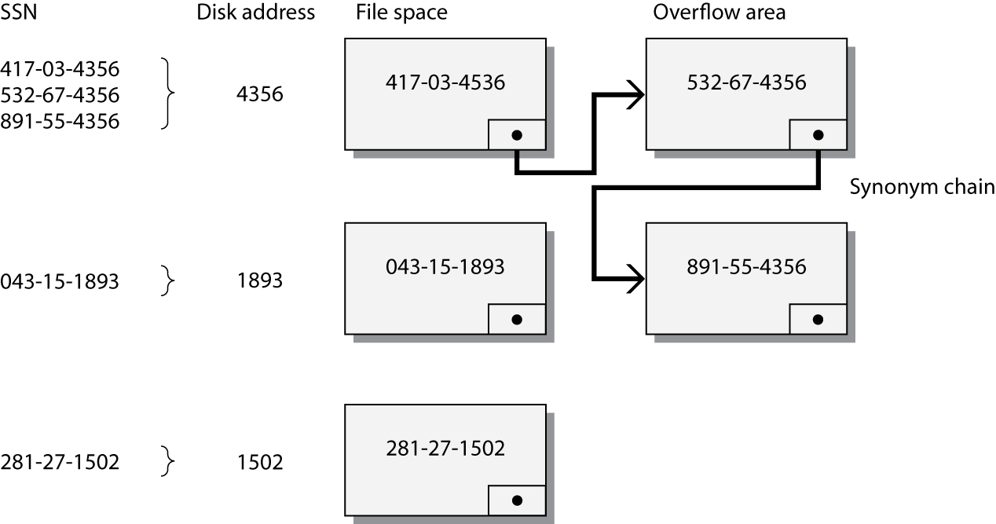
Hashing
hash address = remainder after dividing SSN by 10000

Slide 24
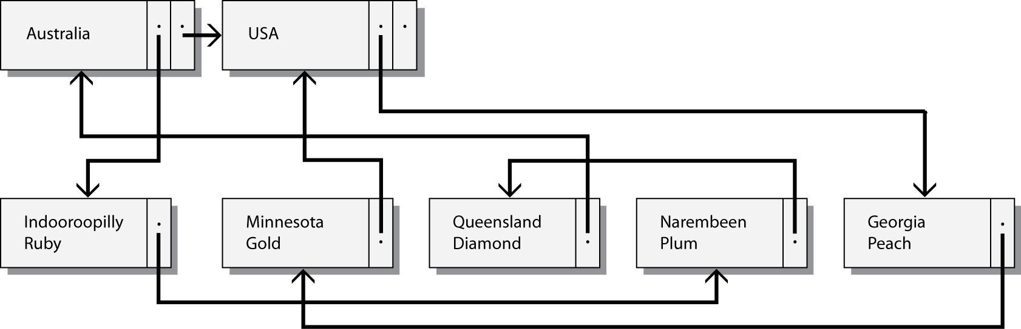
Linked list
A structure for inter-file clustering
An example of a parent/child structure

Slide 25
Linked lists
There can be two-way pointers, forward and backward, to speed up deletion
Each child can have a pointer to its parent

Slide 26
Bit map indexes
Uses a single bit, rather than multiple bytes, to indicate the specific value of a field
  Color can have only three values, so use three bits
Itemcode | Color |  |  | Code |  | Disk address
 | Red | Green | Blue | A | N
1001 | 0 | 0 | 1 | 0 | 1 | d1
1002 | 1 | 0 | 0 | 1 | 0 | d2
1003 | 1 | 0 | 0 | 1 | 0 | d3
1004 | 0 | 1 | 0 | 1 | 0 | d4

Slide 27
Bit map indexes
A bit map index saves space and time compared to a standard index
Itemcode | Color Char(8) | Code Char(1) | Disk address
1001 | Blue | N | d1
1002 | Red | A | d2
1003 | Red | A | d3
1004 | Green | A | d4

Slide 28
Join indexes
Speed up joins by creating an index for the primary key and foreign key pair
nation index |  |  | stock index
natcode | Disk address |  | natcode | Disk address
UK | d1 |  | UK | d101
USA | d2 |  | UK | d102
 |  |  | UK | d103
 |  |  | USA | d104
 |  |  | USA | d105
join index
nation disk address | stock disk address
d1 | d101
d1 | d102
d1 | d103
d2 | d104
d2 | d105

Slide 29
Data coding standards
ASCII
UNICODE

Slide 30
ASCII
Each alphabetic, numeric, or special character is represented by a 7-bit code
128 possible characters
ASCII code usually occupies one byte

Slide 31
UNICODE
A unique binary code for every character, no matter what the platform, program, or language
Currently contains 34,168 distinct characters derived from 24 supported language scripts
Covers the principal written languages
Two encoding forms
  A default 16-bit form
  A 8-bit form called UTF-8 for ease of use with existing ASCII-based systems
The default encoding of HTML and XML
The basis of global software

Slide 32
Data storage devices
What data storage device will be used for
  On-line data
    Access speed
    Capacity
  Back-up files
    Security against data loss
  Archival data
    Long-term storage

Slide 33
Key variables
Data volume
Data volatility
Access speed
Storage cost
Medium reliability
Legal standing of stored data

Slide 34
Magnetic technology
Up to 50% of IS hardware budgets are spent on magnetic storage
A $50 billion market
The major form of data storage
A mature and widely used technology
Strong magnetic fields can erase data
Magnetization decays with time

Slide 35
Fixed disks
Sealed, permanently mounted
Highly reliable
Access times of 4-10 msec
Transfer rates as high as 1,300 Mbytes per second
Capacities of Gbytes to Tbytes

Slide 36
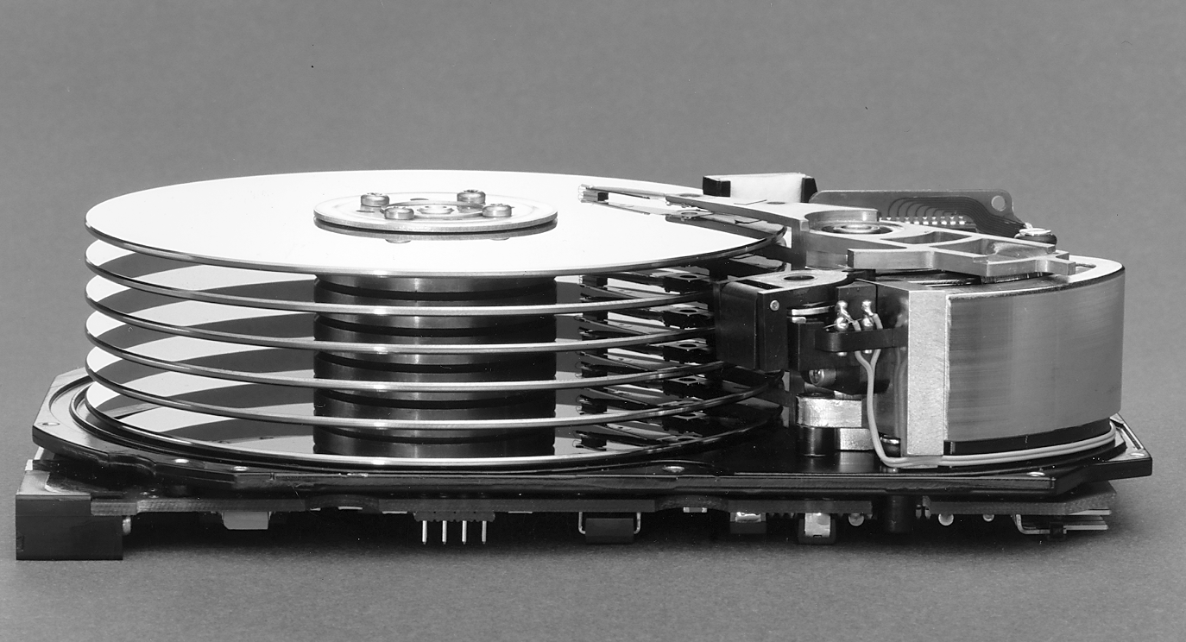
A disk storage unit

Slide 37
RAID
Redundant arrays of inexpensive or independent drives
Exploits economies of scale of disk manufacturing for the personal computer market
Can also give greater security
Increases a systems fault tolerance
Not a replacement for regular backup

Slide 38
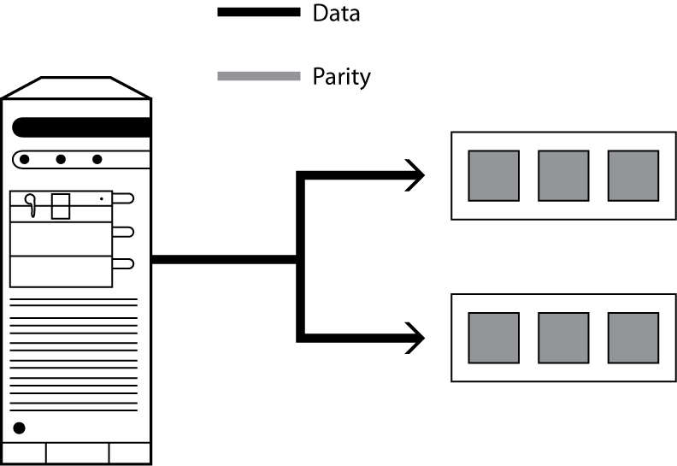
Mirroring

Slide 39
Mirroring
Write
  Identical copies of a file are written to each drive in an array
Read
  Alternate pages are read simultaneously from each drive
  Pages put together in memory
  Access time is reduced by approximately the number of disks in the array
Read error
  Read required page from another drive
Tradeoffs
  Reduced access time
  Greater security
  More disk space

Slide 40
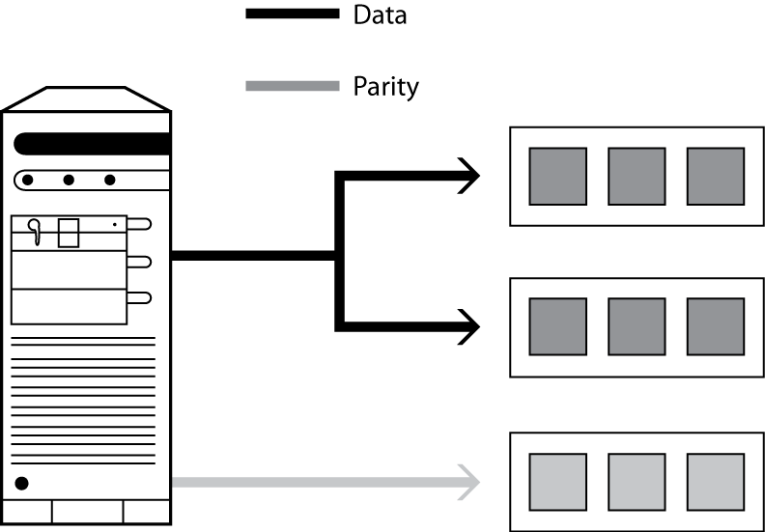
Striping

Slide 41
Striping
Three drive model
Write
  Half of file to first drive
  Half of file to second drive
  Parity bit to third drive
Read
  Portions from each drive are put together in memory
Read error
  Lost bits are reconstructed from third drive’s parity data
Tradeoffs
  Increased data security
  Less storage capacity than mirroring
  Not as fast as mirroring

Slide 42
RAID levels
All levels, except 0, have common features
The operating system sees a set of physical drives as one logical drive
Data are distributed across physical drives
Parity is used for data recovery

Slide 43
RAID levels
Level 0
  Data spread across multiple drives
  No data recovery when a drive fails
Level 1
  Mirroring
  Critical non-stop applications
Level 3
  Striping
Level 5
  A variation of striping
  Parity data is spread across drives
  Less capacity than level 1
  Higher I/O rates than level 3

Slide 44
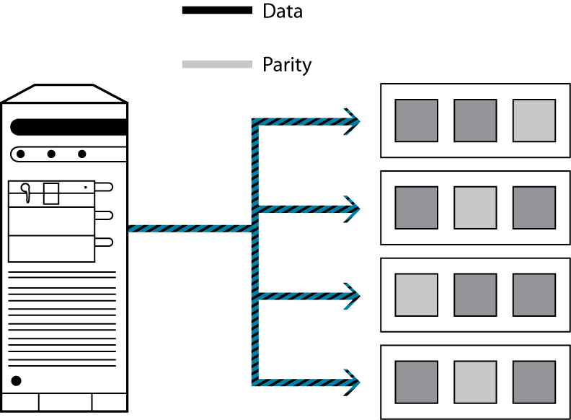
RAID 5

Slide 45
Magnetic technology
Removable magnetic disk
Magnetic tape
Magnetic tape cartridge
Mass storage

Slide 46
Solid State
Arrays of memory chips
Can be 50 times faster than magnetic storage
$1,400 per Gbyte
  Magnetic disk is about $1 per Gbyte
Stock trading and video-streaming applications

Slide 47
Flash drive
Small
Removable
Solid state
USB connector
Up to 2 Gbytes capacity
Around $100 per Gbyte

Slide 48
Optical technology
A more recent development than magnetic
Use a laser for reading and writing data
High storage densities
Low cost
Direct access
Long storage life
Not susceptible to head crashes

Slide 49
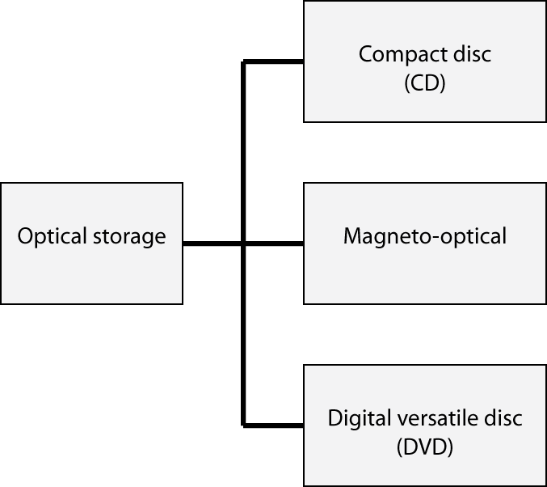
Optical technology

Slide 50
CD-ROM
CD can store data as well as sound
Economies of scale because of common components for CD players and CD-ROM drives
ROM - read only memory
Capacity of 650 M bytes
Relatively slow device
  100 ms access time

Slide 51
Magneto-optical disk
High capacity read-write medium
3.5" disk can store up to 256 M bytes
Not as fast as fixed disk
  10 msec access time
Compact
Reliable
Suitable for data transfer, backup, and archival purposes

Slide 52
Digital Versatile Disc (DVD)
The same physical size as a CD-ROM but up to 28 times the capacity (i.e., 17 Gbytes)
DVD drives are likely to have transfer rates of around 2.76 M bytes/sec and access times of 150 msec
DVD-ROM drive will play both audio CDs and CD-ROMs
Read-only versions
  DVD-Video (movies)
  DVD-ROM (software)
  DVD-Audio (songs)
DVD-R
  Recordable (write once, read many)
DVD-RAM
  Erasable (write many, read many)

Slide 53
SAN
Storage area network
Supports dynamic sharing of large amounts of data, regardless of operating system or application
Communicates via pipelines that consist of an interface called Fibre Channel
  A high speed data connection between computer devices
Prices vary from $20-30,000 to 5 million

Slide 54
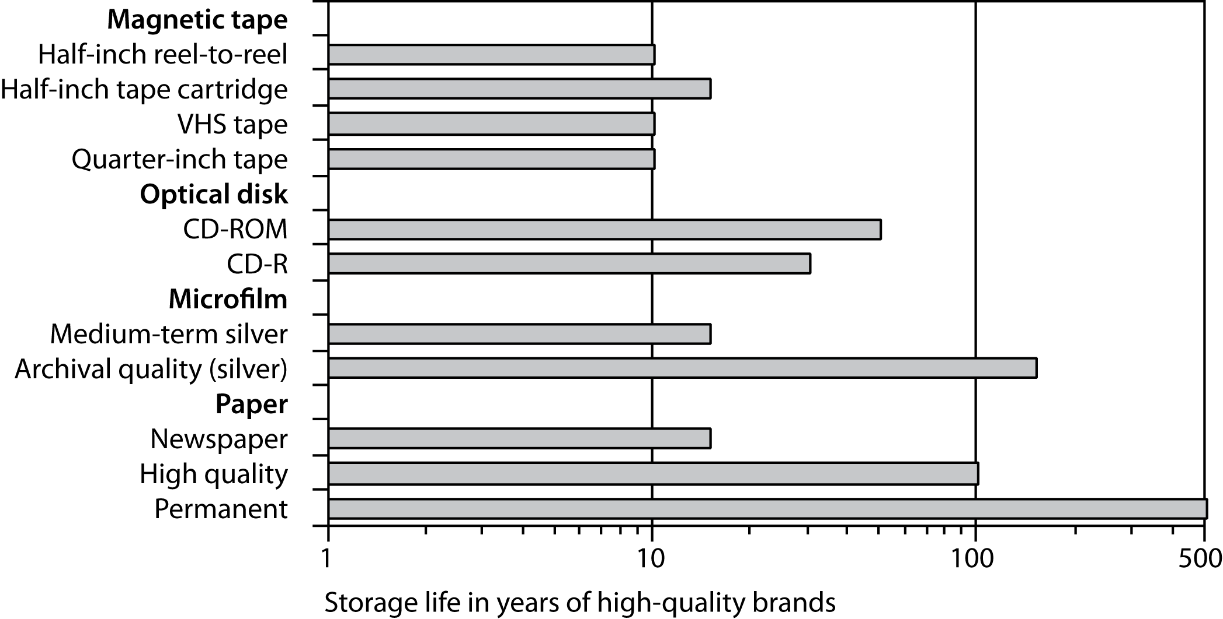
Storage life

Slide 55
Merit of data storage devices
Device | Access speed | Volume | Volatility | Cost per megabyte | Reliability | Legal standing
Solid state | *** | * | *** | * | ** | *
Fixed disk | *** | *** | *** | ** | ** | *
RAID | *** | *** | *** | ** | *** | *
Removable disk | ** | ** | *** | ** | ** | *
Floppy | * | * | *** | * | * | *
Tape | * | ** | * | *** | ** | *
Cartridge | ** | *** | * | *** | ** | *
Mass storage | ** | *** | * | *** | ** | *
SAN | *** | *** | *** | ** | *** | *
CD-ROM | * | ** | * | ** | *** | ***
CD-R | * | ** | * | ** | *** | **
CD-RW | * | ** | * | ** | *** | *
WORM | * | *** | * | *** | *** | **
Magneto-optical | ** | *** | ** | *** | *** | *
DVD-ROM | * | *** | * | *** | *** | ***
DVD-R | * | *** | * | *** | *** | **
DVD-RAM | * | *** | ** | *** | *** | *

Slide 56
Data compression
Encoding digital data so it requires less storage space and thus less network bandwidth
Lossless
  File can be restored to original state
Lossy
  File cannot be restored to original state
  Used for graphics, video, and audio files

Slide 57
Key points
Disk drives are relatively slow compared to main memory
A variety of techniques are used to overcome the disk access bottleneck
Storage devices vary on several parameters
Select a storage device based on storage and retrieval goals

